Slide 1
Adaptive Layer Framework
JET Systems

Slide 2
Introduction
Problem
Proprietary, closed system mission computers on Type 1 and 2 UAS prevent easy, affordable, cross-system visibility into navigation and sensor data.
Incompatible or proprietary representations of the same kind of data
Reinventing the same applications for different platforms
Solution
Open Architecture Framework
Rapidly integrate new capabilities
Extensible environment, modular configurations
Applications are portable to any ALF-enabled platform.

Slide 3
Demo Outline
This technical demonstration will show ALF operating in multiple low-cost configurations:
Adjunct processor to a Fight Computer
Integrated Flight and Mission Computer
Ground Station
Roll-on / Roll-off Independent Hardware
It will demonstrate ALF enabling data collaboration of navigation sensors and other external interfaces in real time.
Perform a sample mission demonstrating multiple Unmanned Systems (UAS and UGV) forming a hybrid ad-hoc mesh network including broadband LTE, Wi-Fi, and Telemetry radios.

Slide 4
Demo Goal
Demonstrate the ALF middleware framework running on different hardware profiles, hosting common applications
Aggregate data from multiple vehicles using different sensors, routed via the ALF middleware to a common backbone
Show flexibility via dynamic ad-hoc mesh networking of nodes with drop-in / drop-out capability

Slide 5
ALF UAS Hardware

Slide 6
Mobile Ad-Hoc Networks (MANET)
A type of network where each device can change locations and reconfigure themselves automatically.
Increases the operational range of unmanned vehicles by routing through other unmanned vehicles
Resiliency through saturation: Network self-heals when routes are damaged if there is an available pathway

Slide 7
Notional Network Topology

Slide 8
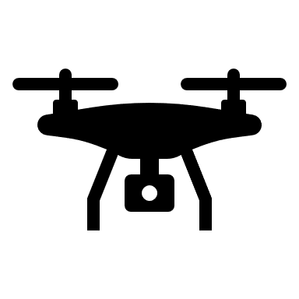
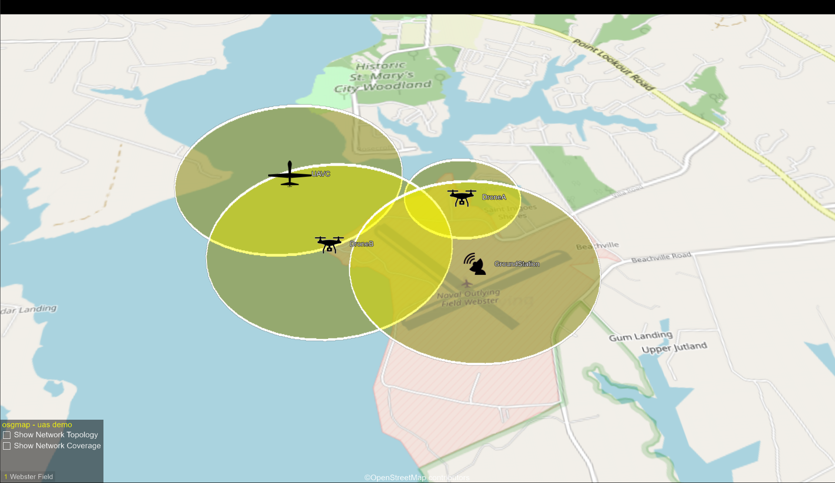
Alternative Network Views
Mesh Routing Network View
Map View
Local Ground Station

Slide 9
ALF Demonstration Nodes
2. Demo UAS Payload
(Adjunct Processor to Flight Controller)
ALF Computer
Mesh Networking
GPS / IMU
Telemetry Radio
Pixhawk Cube Flight Controller
Fixed Wing UAS
(Roll-on / Roll-off Independent Hardware)
ALF Mission Computer
GPS / IMU
Telemetry Radio
3. Autonomous Rover
(Integrated Flight and Mission Computer)
ALF Computer
Mesh Networking
GPS / IMU
Telemetry Radio
4. Ground Station (Mesh Network Bridge)
(Ground Station for connection to Mesh Network)
ALF Computer
Mesh Networking
GPS Receiver
Telemetry Radio Receivers
5. Ground Station (Mesh Network Gateway)
(Ground Station for connection to Remote Networks)
ALF Computer
Mesh Networking
GPS Receiver
7. Remote UAS
(Simulated UAS Sensor)
ALF Computer
Mesh Networking
GPS Receiver
ADS-B Receiver
6. Quadcopter UAS
(Integrated Flight and Mission Computer)
ALF Computer
Mesh Networking
GPS / IMU

Slide 10
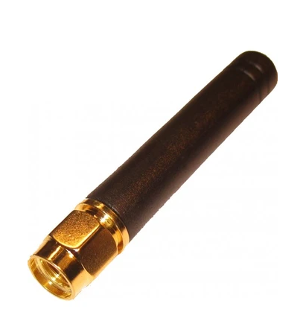
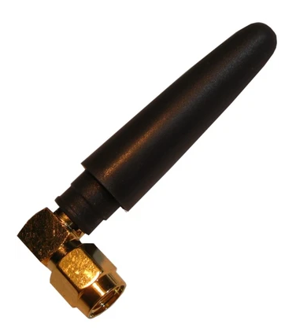
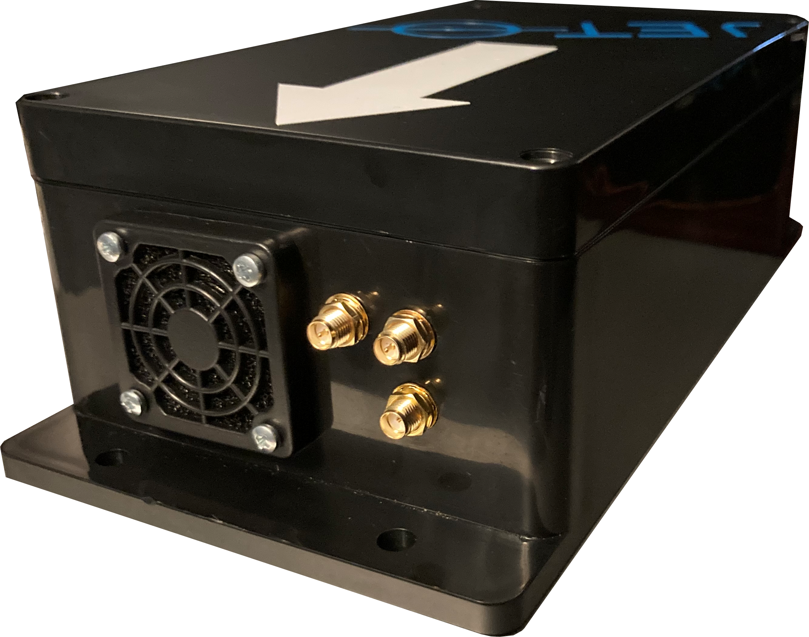
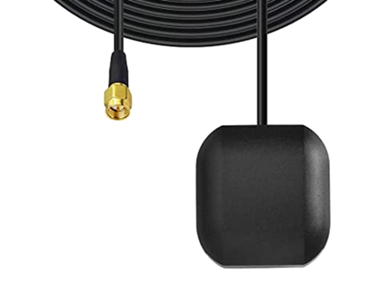
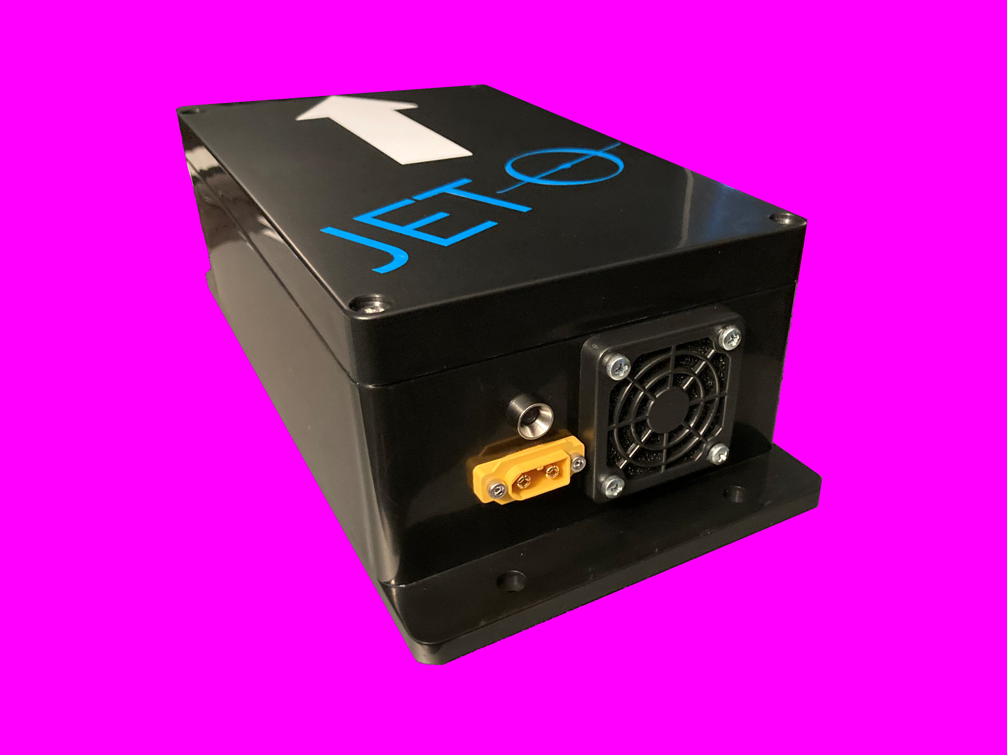
Configurations Overview Roll-on / Roll-off Independent Hardware
Fixed-Wing UAS Stand-alone configuration:
Mission Processor / Flight Controller
ALF Mission Computer with integrated IMU
Sensors: Accelerometers, gyros, compass, barometer, temperature
External GPS Input: 5V DC Active (SMA)
Data Link
Telemetry Radio (900 MHz)
Enclosure
ABS with active cooling
12V DC Power Input Jack

Slide 11
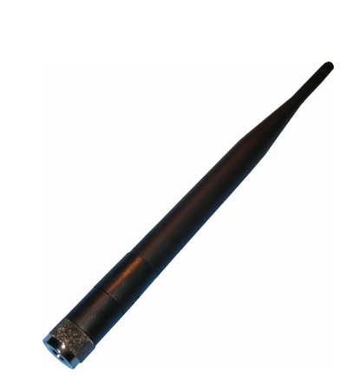
Configurations Overview Adjunct Mission Computer
Demo UAS Payload
Mission Processor
ALF Computer with serial connection to Flight Controller
Flight Controller
Pixhawk Cube 2.1 Flight Controller
Sensors: Accelerometers, gyros, compass, barometer
Internal Integrated GPS / Compass
Data Links
Wi-Fi (2.4 GHz)
Telemetry Radio (900 MHz)
Enclosure
ABS with active cooling
12V DC Power Input Jack

Slide 12
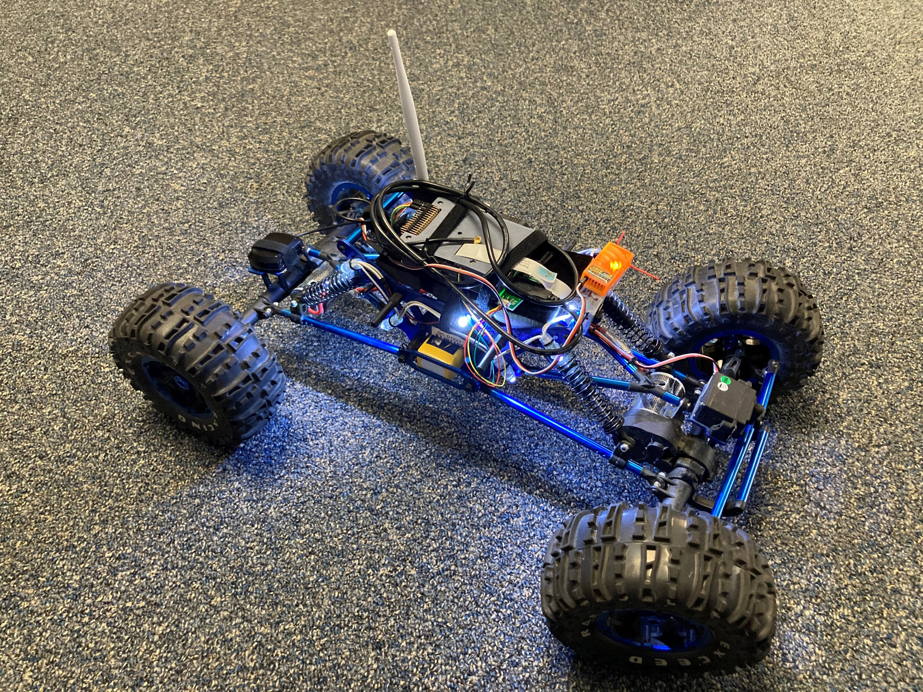
Configurations Overview Integrated Flight and Mission Computer
Autonomous Rover
Mission Processor / Vehicle Controller
ALF Computer with integrated IMU
Sensors: Accelerometers, gyros, compass, barometer, temperature
GPS
Data Links
Wi-Fi (2.4 GHz)
Telemetry Radio (900 MHz)
Controller
2.4 GHz FHSS
Enclosure
Lightweight, passive cooling
12V DC Power Input Jack

Slide 13
Configurations Overview Simulated UAS Sensor
UAS (Providing ADS-B IN)
ALF Computer
Sensors
ADS-B IN via Software Defined Radio (SDR)
GPS
Data Link
Wi-Fi (2.4GHz)
Enclosure
Lightweight, passive cooling

Slide 14
Configurations Overview Ground Station (Bridge)
Ground Station (Provides Mesh Network Interface)
Mission Computer
ALF Computer
Raspberry Pi 4 running ALF UAS
GPS
Data Link
Wi-Fi (2.4GHz)
Telemetry Radio (900MHz)
Enclosure
Lightweight, passive cooling

Slide 15
Configurations Overview Ground Station (Gateway)
Ground Station (Provides Wide Area Network Interface)
Mission Computer
ALF Computer
Raspberry Pi 4 running ALF UAS
Sensors: Accelerometers, gyros, compass, barometer, temperature
GPS (Navio or LTE GNSS)
Data Link
Wi-Fi (2.4GHz)
Enclosure
Lightweight, passive cooling

Slide 16
ALF

Slide 17
The Need: Smart Solutions
Problem:
Slow Integration and Vendor Lock
Currently, capability developmental approaches are based on proprietary Data Rights making changes to OEM systems and integrations costly, requiring significant and unnecessary cost and schedule for development and testing.
Solution:
Smart Aircraft Environment
The Adaptive Layer Framework (ALF) is an Open Architecture framework that bridges the disconnect between legacy systems and enables truly “Smart Aircraft” environment based on government-owned data rights, modularity, extensibility, and software re-use.

Slide 18
The Way Forward
Challenges
Solutions
Inter/Intra Service Communication
Common ALF middleware integration allows for easily-shared capabilities
Programming to a common ALF opens all components up to competition in the free market
Vendor Lock
Duplication of Efforts
Government will be able to search for pre-developed apps from the DoD Store
Vendors will be able to develop capabilities to the common ALF ahead of the need
Speed-to-fleet
Breaking vendor lock does not BLOCK vendors; it frees the Government to have options, and increases speed of integration

Slide 19
What is ALF?
Legacy System Development
Built Uniquely – (Stove-piped)
Not Modular
Not Re-usable
Legacy System upgrades are slow and expensive
HW
Sensor
HW
Sensor
OFP
Sensor
Sensor
App
HW
Sensor
ALF
App
App
Sensor
ALF is Modular
Maximizes speed of capability to the end-user
Maximizes commonality
Minimizes schedule of development through software re-use
ALF hosts applications that can access common software components
ALF communicates with sensors and hardware using standard data formats
SMART MC
All ALF-compatible Applications, Services, and Data are shared with all ALF-enabled Platforms
Changes to a single ALF-compatible component benefits ALL ALF-enabled Platforms
HW

Slide 20
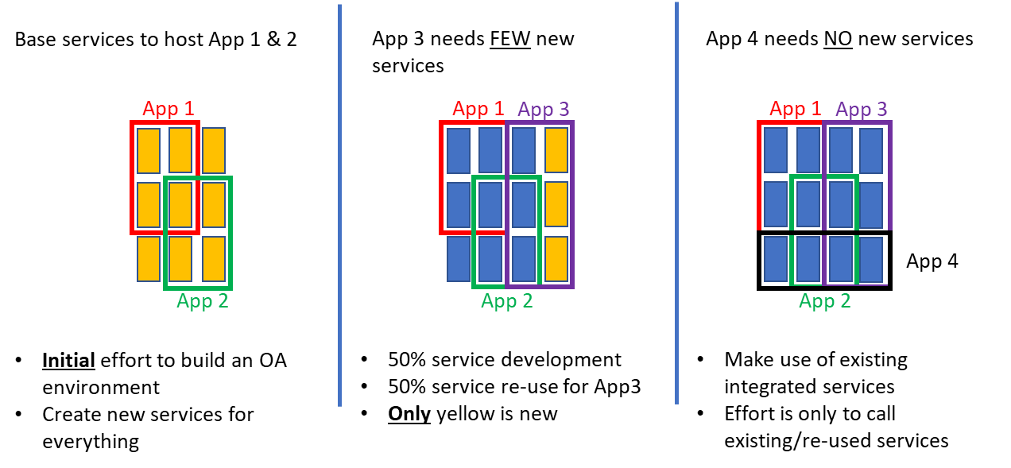
Software Re-use
Faster Capability Integration
ALF promotes Software Re-use via Apps that interface using Common Services
Software re-use correlates directly with reduced development cost (resource and schedule) when integrating capabilities onto platforms

Slide 21
ALF Baseline and Beyond
ALF Baseline
Framework and Common Services
Governs system operation and memory management
ALF Enabled Interfaces
Provides common external communications protocol support
Ethernet, Serial, Discrete I/O, USB, etc.
Application Layer
Software Development Kit (SDK) for ALF Developers
Supports rapid prototyping and deployment
Application Repository (Store)
Collaborative development

Slide 22
System of Systems
The ALF middleware is just part of the larger vision that enables:
Rapid Capability Integration through shared Services and Applications
Collaborative development across DOD and Industry
Stronger response to current and emerging Cyber threats
Common and secure communication and data sharing across Domains
Significantly reduced and more modular regression testing
Rapid Integration
Cost Reduction
• • • • • • • • • • • • • • • • • • • • • • • • • •
Collaboration
Faster and more common integrations allow for
greater innovation of ideas and capabilities
ALF
Cross Domain
Cyber Security

Slide 23
Cross-Platform Deployment
Mission System
F
Data Links
MIL-STD-1553 • Ethernet • Serial • ARINC 429 • HDMI • VGA •
ALF
EOIR
MIL-STD-1553B• Ethernet • • ARINC 429 • Radios • Serial •
Data Links
ALF systems are rapidly configurable and deployable to maximize software reuse and minimize logistics.
ALF
Radar
Radar
Mission System
F
Data Links
Ethernet • GPS • HDMI • Sensors • Radios • Spekers •
ALF
ADS-B
MIL-STD-1553B • Ethernet • Radios • Serial • HDMI • Weapons Systems •
Data Links
ALF
Remote Video Display
Mission System

Slide 24
Multi-Domain Operations
Multi-Domain Warfare enables:
Communication and data sharing across Space, Air, Land, Sea, and Cyber
Communication and data sharing across major entities such as our military branches and coalition forces
Mission System
F
Data Links
MIL-STD-1553 • Ethernet • Serial • ARINC 429 • HDMI • VGA •
ALF
EOIR
MIL-STD-1553B• Ethernet • • ARINC 429 • Radios • Serial •
Data Links
ALF
Radar
Enabling Multi-Domain Warfare requires:
Common capabilities across platforms
Common capability interfaces for both hardware and software
Radar
Mission System
F
Data Links
Ethernet • GPS • HDMI • Sensors • Radios • Spekers •
ALF
ADS-B
MIL-STD-1553B • Ethernet • Radios • Serial • HDMI • Weapons Systems •
Data Links
ALF
Remote Video Display
Mission System

Slide 25
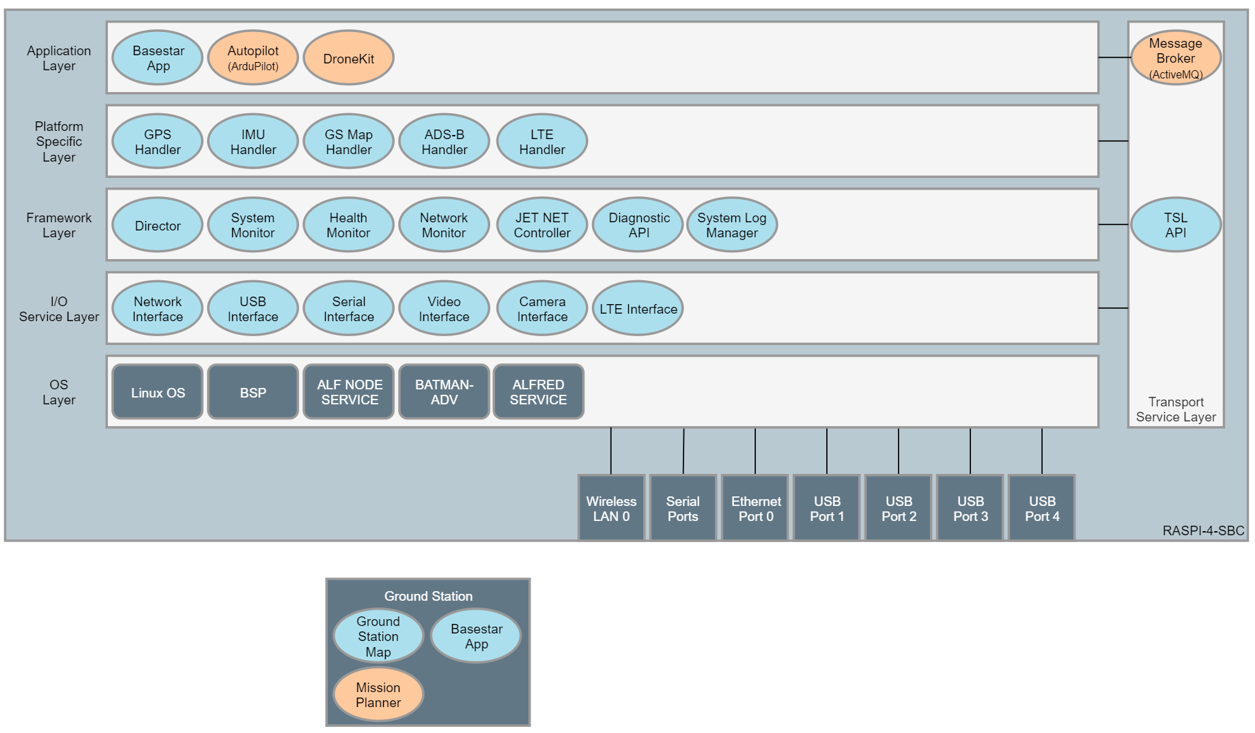
Sample ALF UAS Architecture
Each circle represents an encapsulated, modular software unit.

Slide 26
ALF – What isn’t it?
ALF is not a standard.
It is a framework that implements multiple standards, from communication standards (i.e., IEEE 802.3) or architectural standards (FACE, OMS, etc.)
It can be extended and configured to implement new or additional standards based on requirements.
ALF is not a data model.
ALF leverages existing data models but does not enforce one of its own.
The ALF philosophy is to leverage existing Navy, DOD, and industry data modeling efforts and integrate them into the framework, instead of creating another competing model.
ALF is not a specific hardware implementation
ALF as a framework and is adaptable to a wide range of hardware and operating environments.

Slide 27
ALF – Purpose in the demo
ALF provides life cycle management for apps handling data collection, processing, distribution, and display
The ALF Transport Service Layer (TSL) provides a common methodology to route data between UAVs and Ground Stations, across different communication types and protocols
The ALF Framework handles the set up and management of the ad-hoc, mesh networking.
ALF’s data backbone provides data quality of service and redundancy capabilities

Slide 28
Today and Tomorrow
Today we see a solution to tracking proprietary and disparate unmanned systems into a common operational profile, which can be extended to communicate with ATC or a local white cell, or other forces and services
Tomorrow we can extend this technology to enable systems to work and collaborate in ways that are not possible today

Slide 29
Backup Slides

Slide 30
JET Systems Adaptive Layer Framework (ALF)
System/Technology Description
JET Systems’ Adaptive Layer Framework (ALF) is a platform-agnostic, modular software and hardware system leveraging open architecture design creating common operating environments enabling ad-hoc networking and data collaboration across multiple unmanned system types and ground stations.
Internally, ALF provides abstracted software modules for connections to individual sensors, data storage devices, and communication technologies, and enables applications (Apps) that allows for re-use of sensor integrations and tactical applications across any ALF-enabled system.
Operational Utilization
ALF is a middleware software environment that enables scalable and extensible capability in manned/unmanned flight/mission computers and promotes cross-domain operations through data-centric collaboration.
ALF implemented as an unmanned mission processor can functions as a stand-alone system, can be integrated into existing systems, or could be configured to operate as a combined flight controller and mission processor for Group 1/2 UAS or UGV.
Warfighter Benefits
ALF enables modular, reusable software components that rapidly increases the rate of development and integration resulting in reduced cost and schedules in delivering capability to the fleet.
Demonstration Description
This technical demonstration will show ALF operating in a low-cost UAS/UGV Flight/Mission Computer. It will demonstrate ALF enabling data collaboration of navigation sensors and other sensors during execution a sample mission involving multiple Unmanned Systems (UAS and UGV) forming a hybrid network including broadband LTE, the Internet, and other radios forming adaptive, ad-hoc and mesh networks to relay real-time sensor and position data to a local or remote Ground Station(s) for display.

